Slide 1
COMP 3500 Introduction to Operating Systems Project 5 – Virtual Memory Manager Part 4: Implementing LRU in TLB
Dr. Xiao Qin
Auburn University http://www.eng.auburn.edu/~xqin
xqin@auburn.edu

Slide 2
From Data Structures to Algorithms
Data Structure
Algorithm Design
Implementation

Slide 3
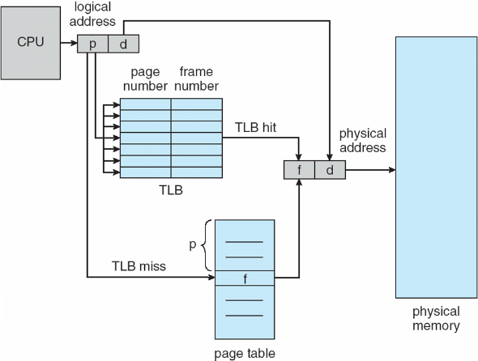
Paging Hardware with Translation Look-aside Buffers (TLB)

Slide 4
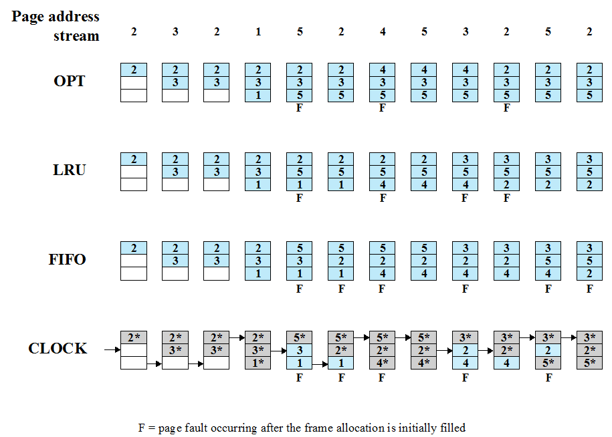
Notes:
The optimal policy selects for replacement that page for which the time to the next
reference is the longest. It can be shown that this policy results in the fewest number of
page faults [BELA66]. Clearly, this policy is impossible to implement, because it would
require the operating system to have perfect knowledge of future events. However, it
does serve as a standard against which to judge real-world algorithms.
Figure 8.14 gives an example of the optimal policy. The example assumes a
fixed frame allocation (fixed resident set size) for this process of three frames. The
execution of the process requires reference to five distinct pages. The page address
stream formed by executing the program is
2 3 2 1 5 2 4 5 3 2 5 2
which means that the first page referenced is 2, the second page referenced is 3, and
so on. The optimal policy produces three page faults after the frame allocation has
been filled.

Slide 5
Exercise 1
Work with your group member to extend the data structure of TLB, where the LRU replacement policy will be implemented:
typedef struct {
page_t page_num;
frame_t frame_num;
bool valid; /* indicate if this entry is valid */
}tlb_entry_t;
typedef struct {
tlb_entry_t tlb_entry[TLB_SIZE];
u_int_t next_tlb_ptr; /* next candidate entry to be replaced/used */
}tlb_t;

Slide 6
Exercise 2
Work with your group member to design the LRU replacement policy for your TLB.
typedef struct {
page_t page_num;
frame_t frame_num;
bool valid; /* indicate if this entry is valid */
}tlb_entry_t;
typedef struct {
tlb_entry_t tlb_entry[TLB_SIZE];
u_int_t next_tlb_ptr; /* next candidate entry to be replaced/used */
}tlb_t;

